Slide 1
Mumbai
GFRC FACADES
CREATING LANDMARKS WITH GRC

Slide 2
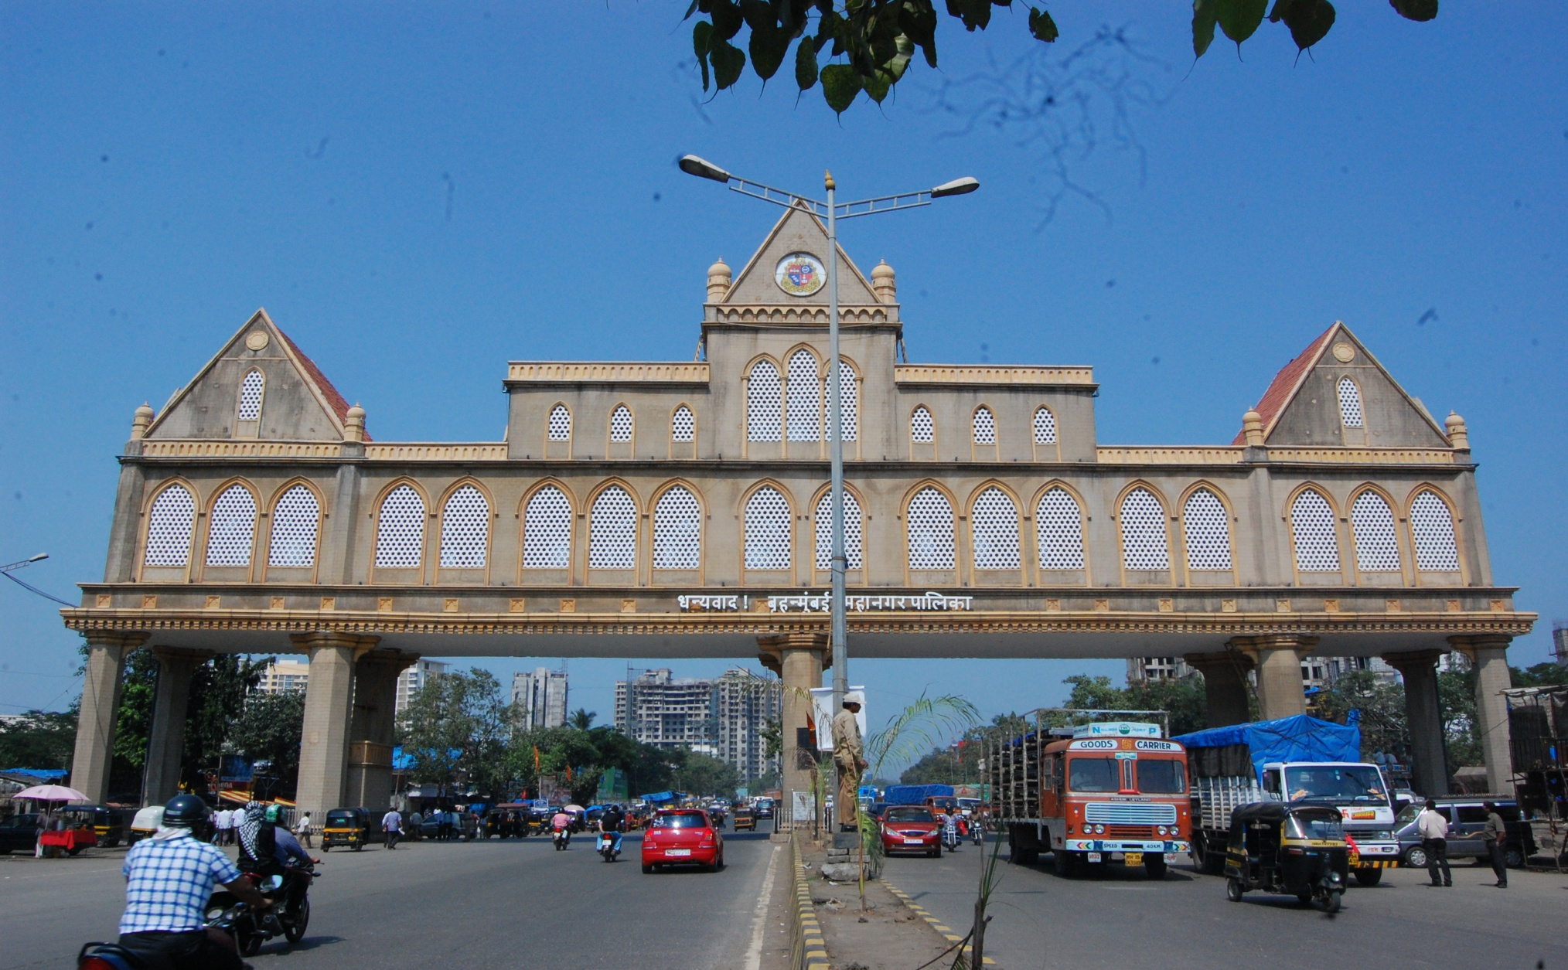
GfRC facades
WELCOME’S YOU TO MUMBAI – DHAISAR CHECK NAKA DECORATED WITH GRC

Slide 3

GRC AT ITS BEST
COMPOUND WALL WITH GRILL & STONE FINISHED PANELS FOR MUSEUM

Slide 4
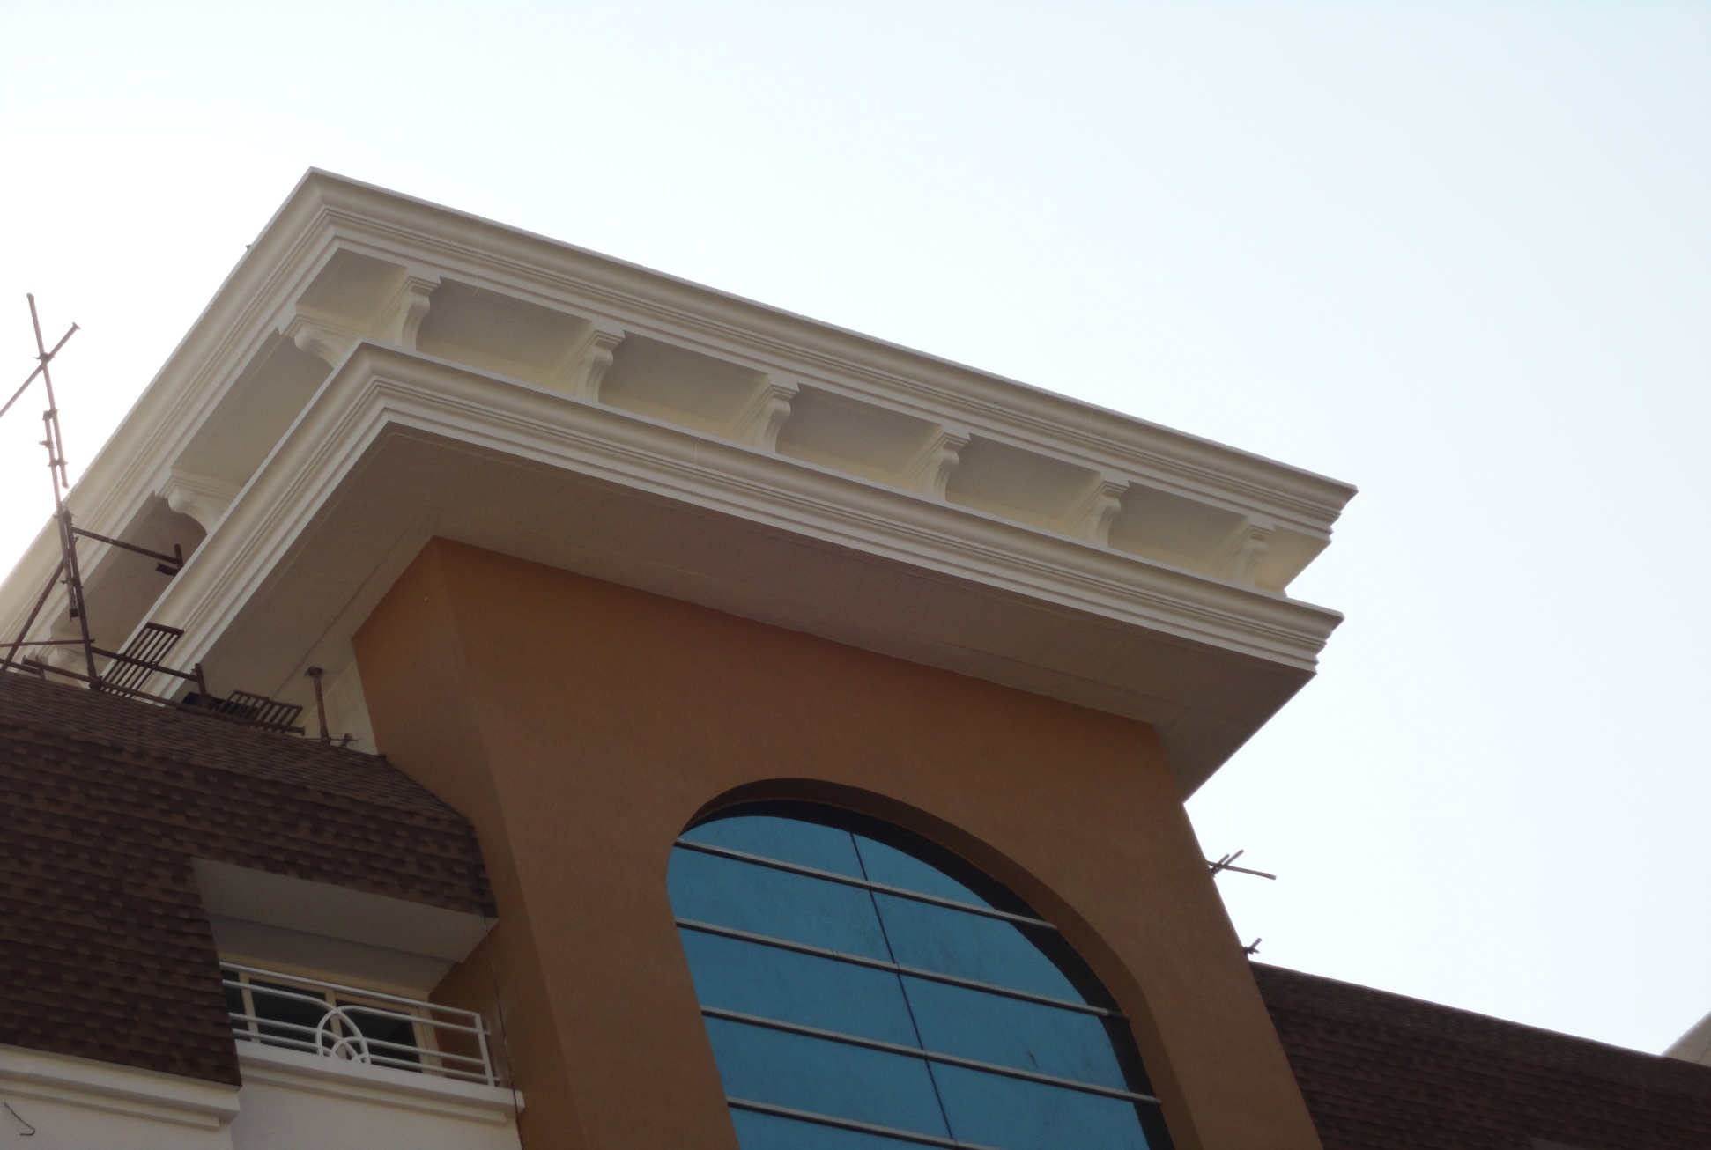
GRC CORNICES & BRACKETS
AT DADAR CLUB

Slide 5
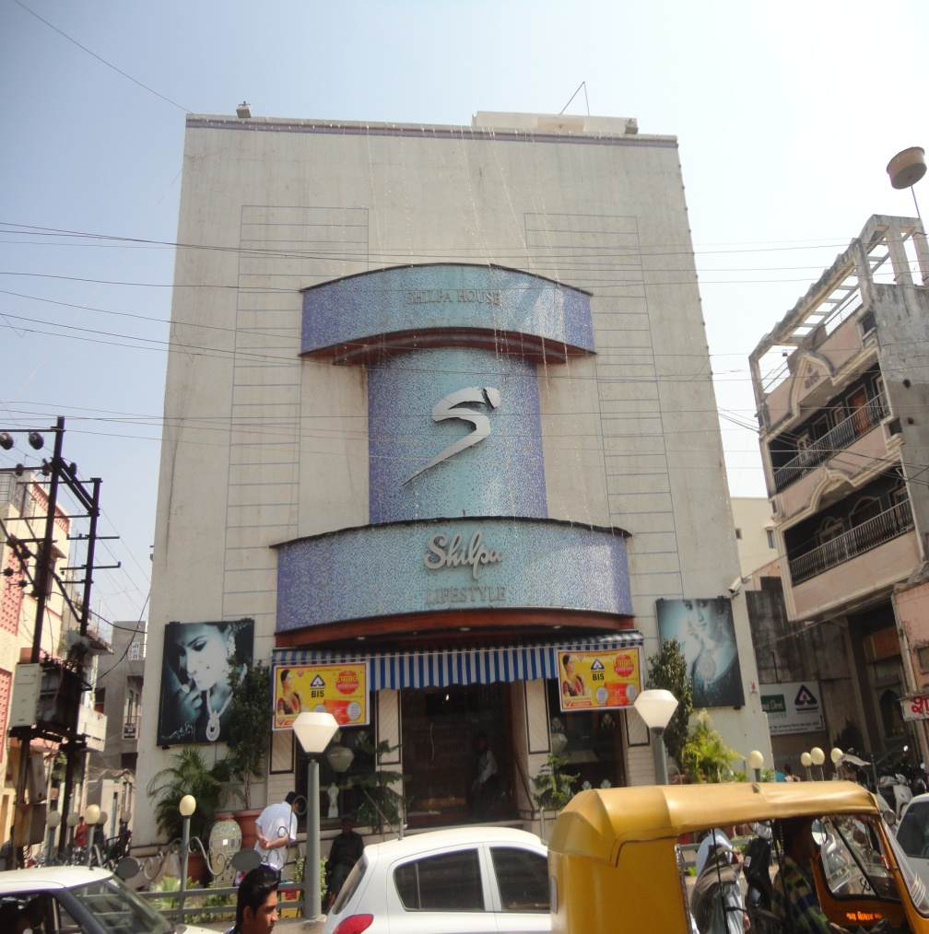
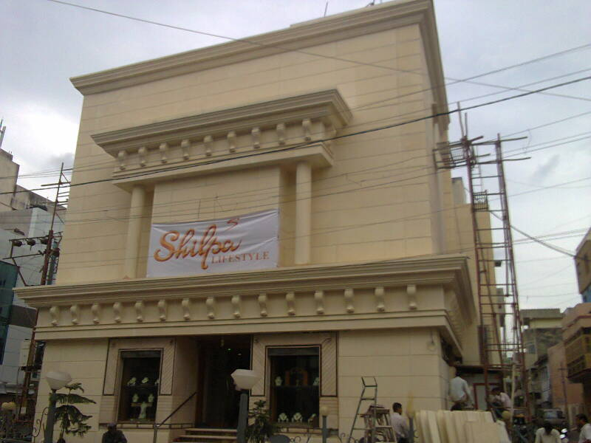
STONE FINISH (ACID WASHED) IN GRC
WALL CLADDING – before & after

Slide 6
WHAT IS GRC?
GLASS REINFORCED CONCRETE
Glass fibre Reinforced Concrete (GRC) is a cement-based composite material reinforced with alkali-resistant fibres.
The fibres add flexural, tensile and impact strength and the resulting material allows the production of strong yet lightweight products used in architectural, civil engineering and many other applications.
GRC is not a single material but a family of materials with different properties tailored to suit particular applications. The properties of GRC vary with the production method, the amount and type of glass fibre and the composition of the cementitious matrix.
The properties of Glass fibre Reinforced Concrete (GRC) vary according to the production method, mix design, and the type and content of the alkali resistant Glass fibre:

Slide 7
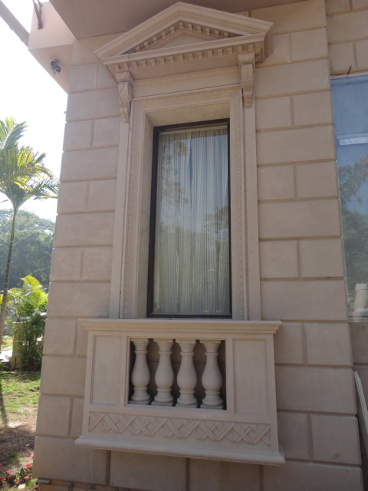
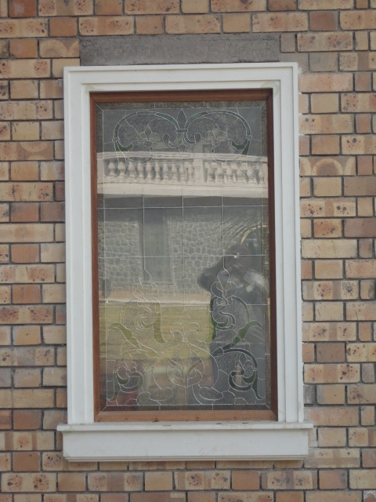
GRC IS A VERSATILE MATERIAL
GRC CAN BE MOLDED TO ANY FORM SO SPUR YOUR IMIGNATION……..

Slide 8
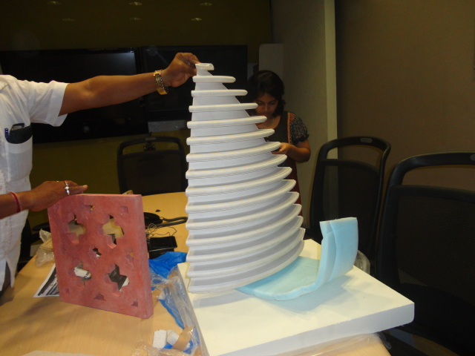
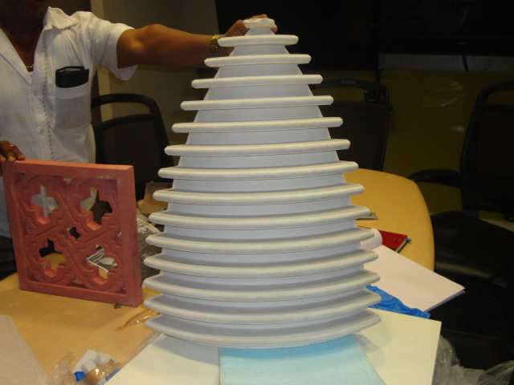
MANUFACTURING GRC
GRC ELEMENTS CAN BE PRODUCED IN VARIOUS WAYS DEPENDING ON THE ELEMENT

Slide 9
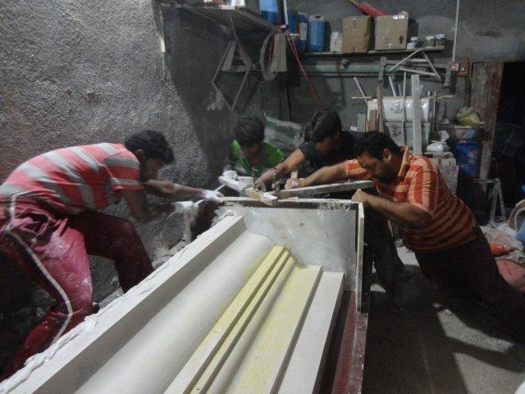
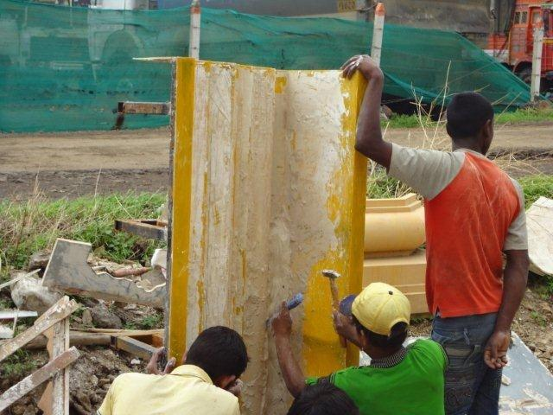
GRC IN PRODUCTION
A PREVIEW INTO ITS PRODUCTION TECHNIQUE

Slide 10
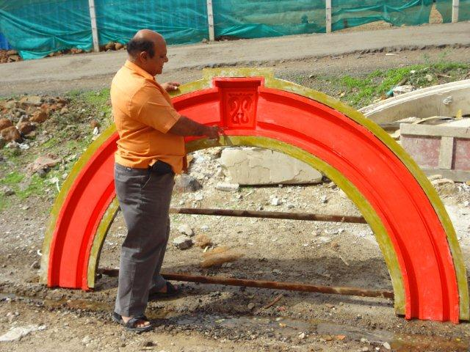
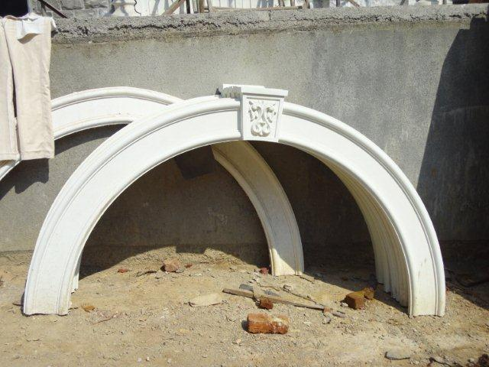
THE ARCH
MOLD IN RUBBER AND THE GRC ELEMENT

Slide 11
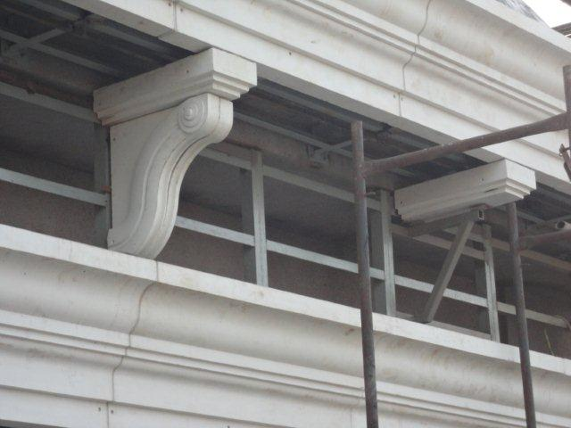
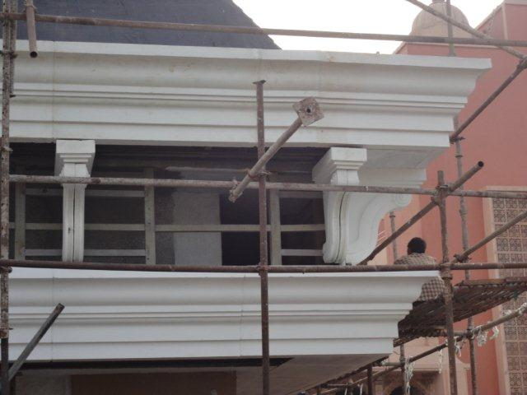
INSTALLATION OF GRC
ON STEEL FRAME WORK

Slide 12
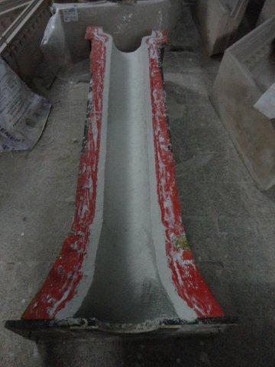
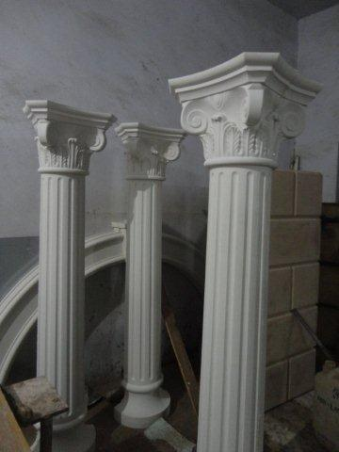
COLUMN & CAPITAL IN GRC
GRC CASTED IN RUBBER MOLDS FOR SUPERIOR FINISH & MAXIMUM REPEATS

Slide 13
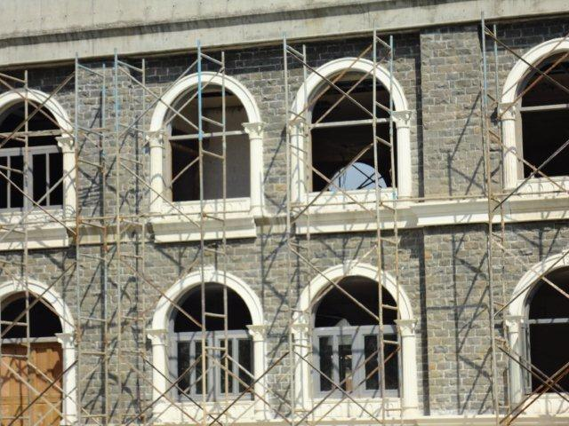
THE WINDOW SURROUND IN GRC
COLUMN, CAPITAL, ARCH 7 WINDOW BOTTOM FIXED AS PER DETAIL

Slide 14
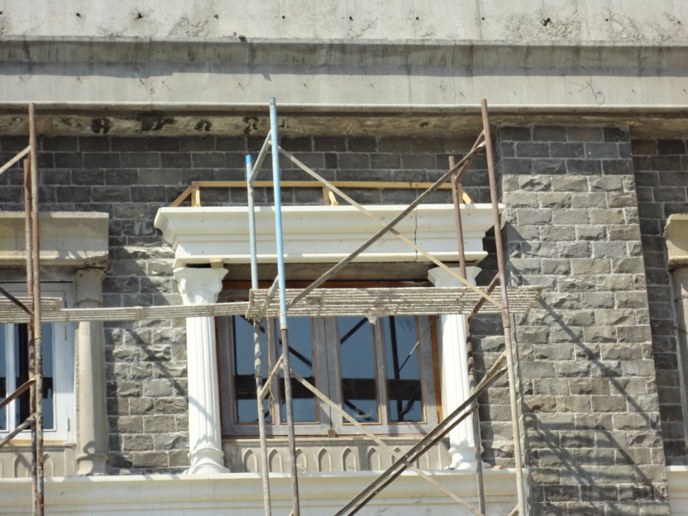
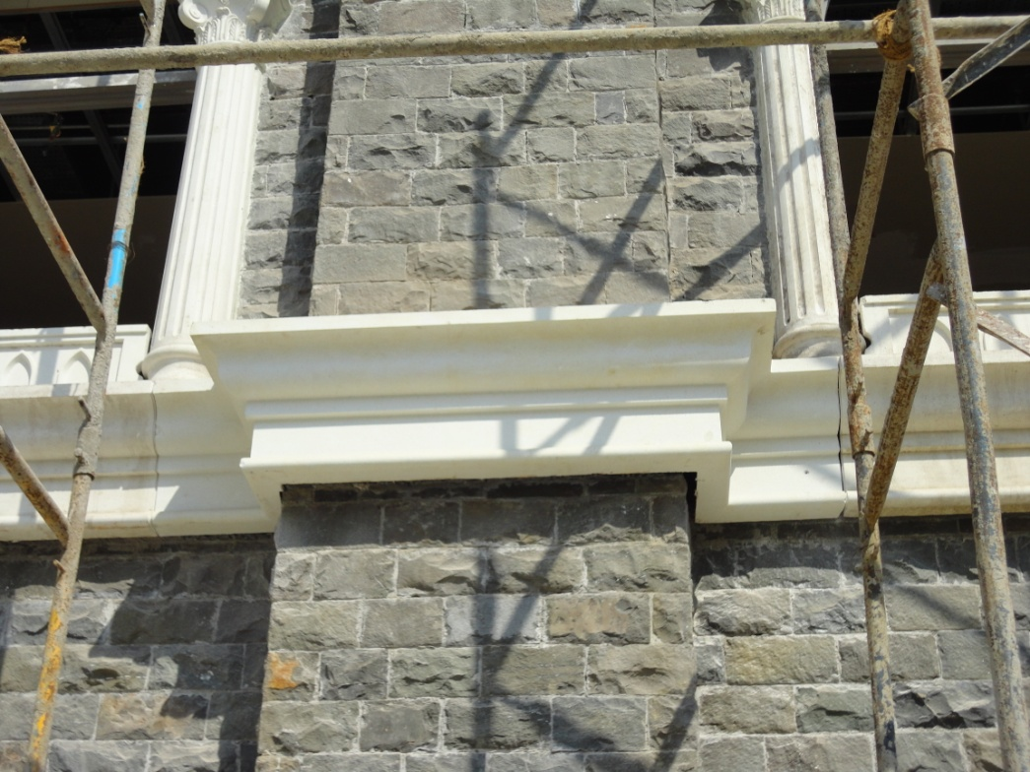
CORNICES IN GRC
LARGE CORNICE OVER WINDOW & CORNICE BAND

Slide 15
ADVANTAGES ON USING GRC
THE BENEFITS ARE MANY AND THIS IS THE REASON OF ITS GAINING POPULARITY
Lightweight Products
Although GRC has a similar density to concrete, the products made from it are many times lighter due to the thin 10-15mm skin thickness used. A cladding panel manufactured from 100mm thick precast concrete would weigh 240kgs per m2 compared to a similar GRC panel of 40-50kgs/m2. In fact many GRC products can be lifted and carried by hand.
Corrosion and Rot Proof
GRC products do not contain mild steel reinforcement and the problems associated with corrosion of reinforcement do not apply. GRC is unaffected by external exposure and will not rot. It is completely unaffected by exposure to UV light.
Incombustible
Most GRC formulations comply with non-combustible criteria for UK and EU standards. Polymer GRC is not classed as non-combustible but conforms to the requirements of Class O defined by the British Building Regulations.

Slide 16
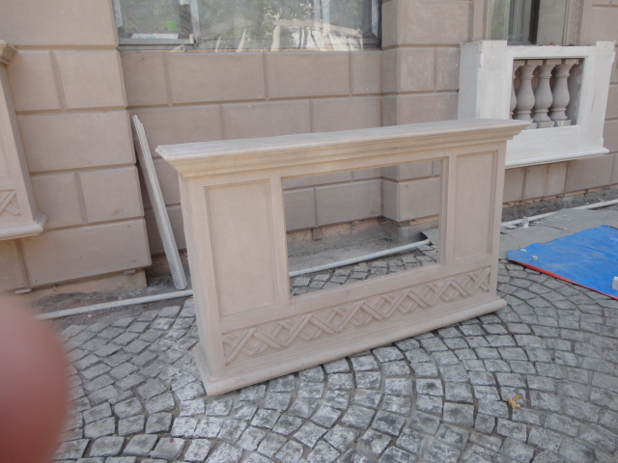
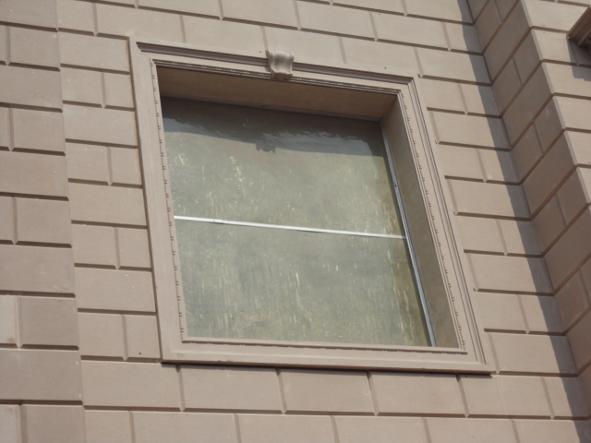
WITH GRC,WE HELP YOU TURN YOUR…….
IMIGNATION INTO REALITY

Slide 17
ADVANTAGES ON USING GRC
THE BENEFITS ARE MANY AND THIS IS THE REASON OF ITS GAINING POPULARITY
Appearance
GRC has a wide flexibility in design and manufacture, which enables it to reproduce most architectural styles and features. It can replicate virtually any surface detail and reproduce the appearance of materials such as stone, slate, terracotta and marble. Carved stonework involves specialised skills and is slow to produce making the end product expensive. GRC can match stonework in appearance and as it can be produced in thin sections it is easier to handle and fix.
Cost Effective
GRC Products have been shown to provide economic solutions to many applications. Although the manufacturing costs may be higher than say concrete, when the reduced handling, transport and fixing costs are considered, there can be an overall saving

Slide 18
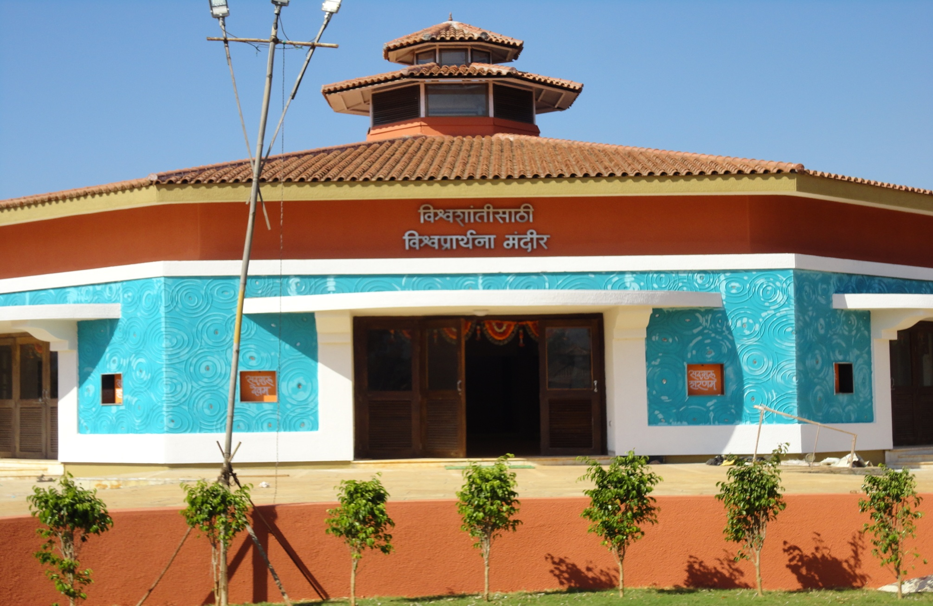
GRC ADDING VALUE & AESTHETICS

Slide 19
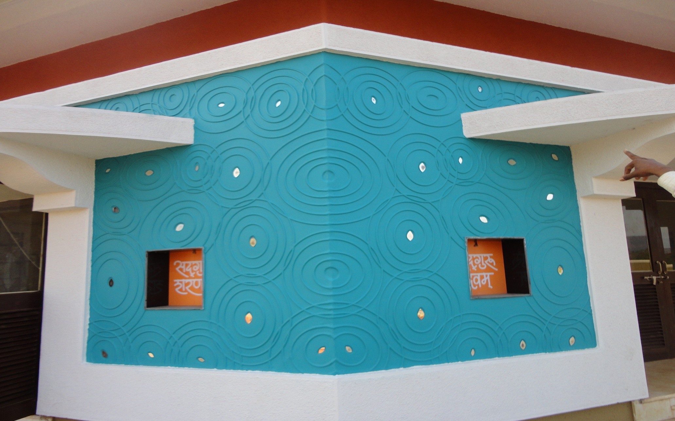
DESIGNER WALL PANEL
DESIGN UNLIMITED

Slide 20
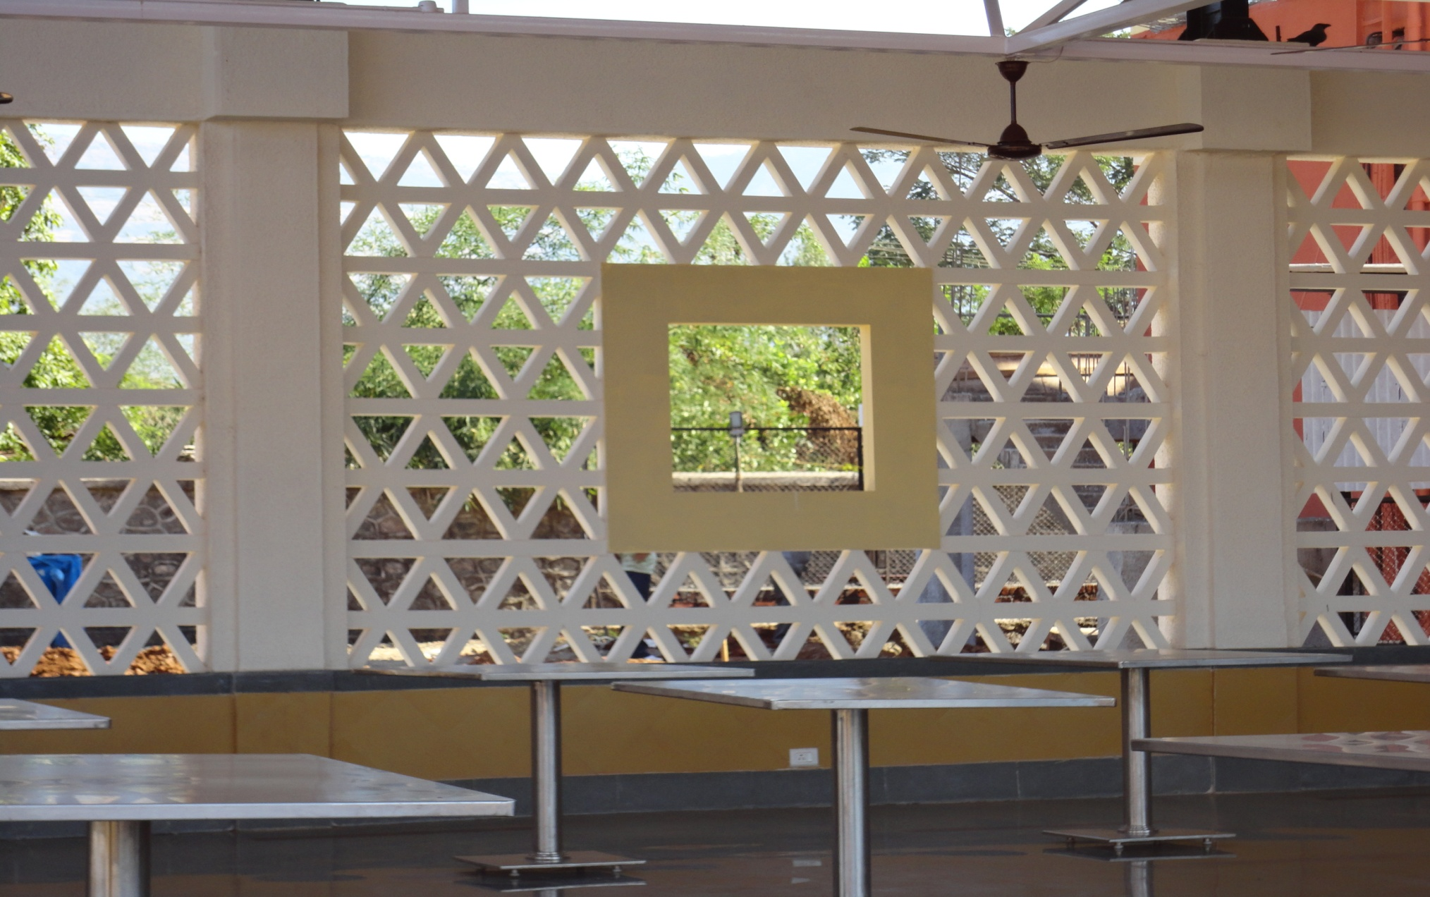
GRC WINDOW GRILL
AT KARJAT ASHRAM

Slide 21
SOME TYPICAL GRC FORMULATIONS……..
MATERIAL | SPRAY (KGS) | CASTING (KGS)
cement | 50 | 50
fine aggregate | 50 | 50
plasticiser | 0.5 | 0.5
polymer | 5 | 5
Water | 13.5 | 14.5
AR glassfibre | 4.5-5% | 2-3.5%

Slide 22
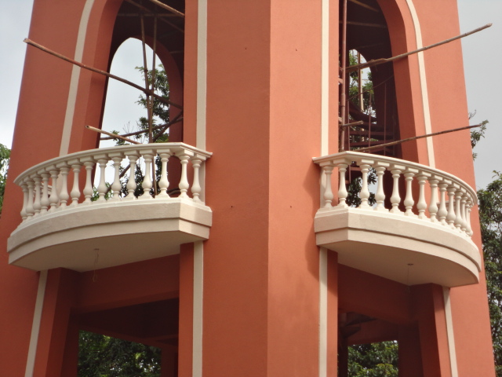
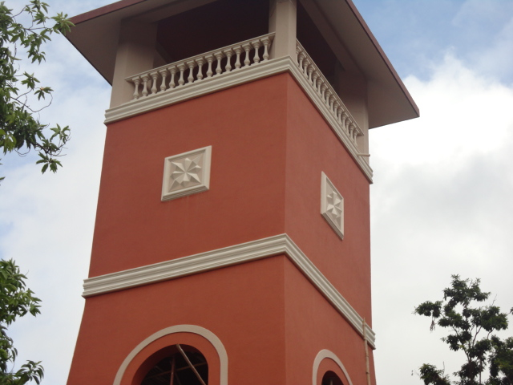
GRC ADDING VALUE TO EXTERIORS
A WATER TANK ADDED WITH GRC ELEMENTS – BALUSTERS,CORNICE & DECORATIVE ELEMENT.

Slide 23
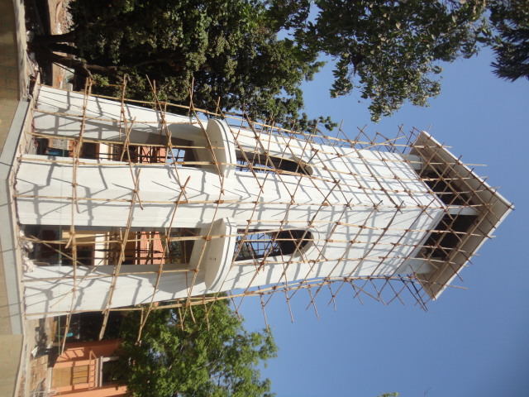
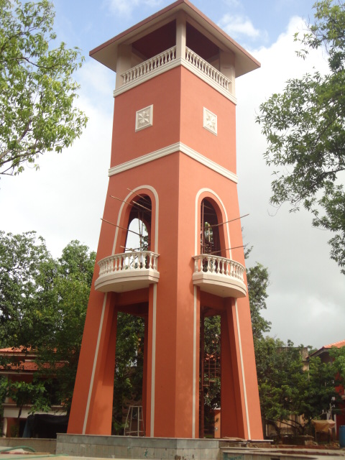
GRC ADDING VALUE TO EXTERIORS
A WATER TANK ADDED WITH GRC ELEMENTS – BALUSTERS,CORNICE & DECORATIVE ELEMENT.

Slide 24
Key features
GRC is environmentally friendly
GRC products reduce loadings on buildings leading to significant savings in superstructure and foundations.
GRC is excellent for reproduction and renovation.
GRC provides the designer with a complete technology that few other materials can match for versatility.

Slide 25
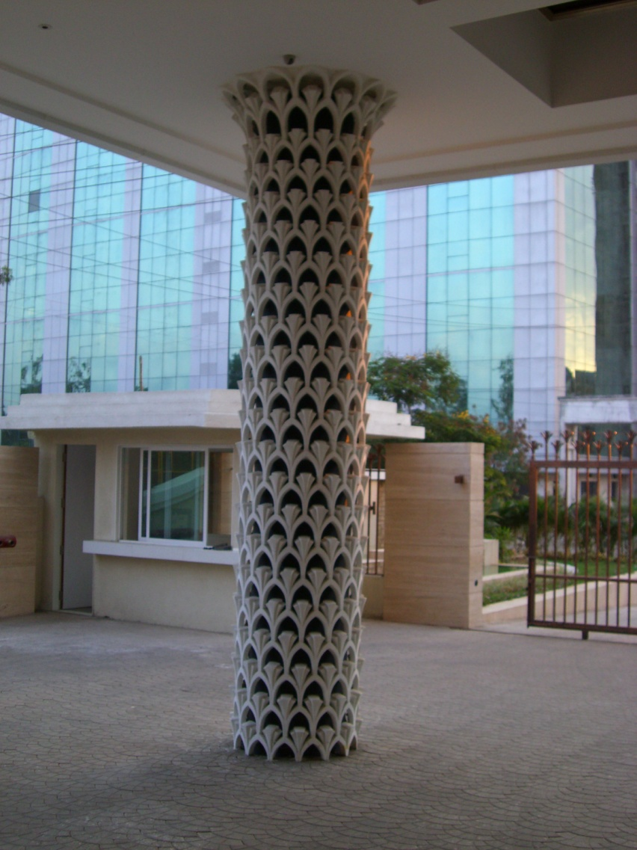
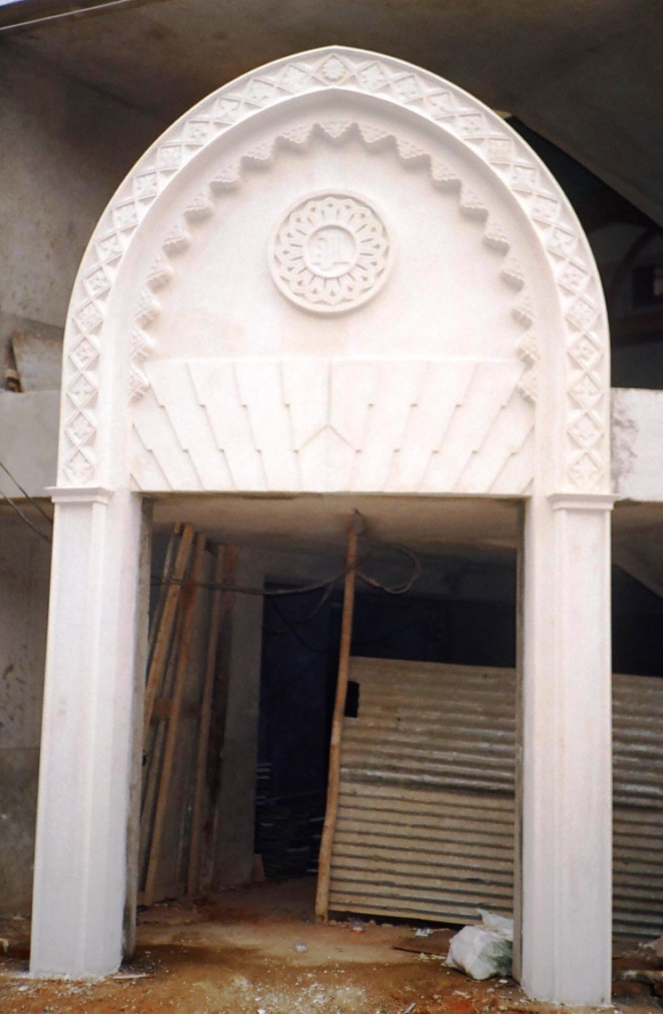
ARCHITUCTURE AT ITS BEST WITH GRC
COLUMN CLADDING & DECORATIVE ENTERANCE

Slide 26
USES OF GRC - CLADDING
GRC is one of the most popular materials used for creative prefabricated architectural cladding. GRC’s ability to be moulded into thin, lightweight panels with a wide variety of shapes, forms and surface finishes has been appreciated by a growing audience of architects and engineers worldwide.
GRC is easily moulded to reproduce shapes, details and textures
GRC is high strength allows design of thin, lightweight cladding elements
GRC can be coloured with pigments, paints and natural stone facings
GRC cladding can replace non-structural precast concrete where weight and/or shape may be problematic
GRC cladding panels are generally manufactured by the ‘Hand Spray’ technique. As the name implies, the material is sprayed into a mould using special machinery. The method can produce high-performance materials from which panels with extremely thin, lightweight sections are achievable.

Slide 27
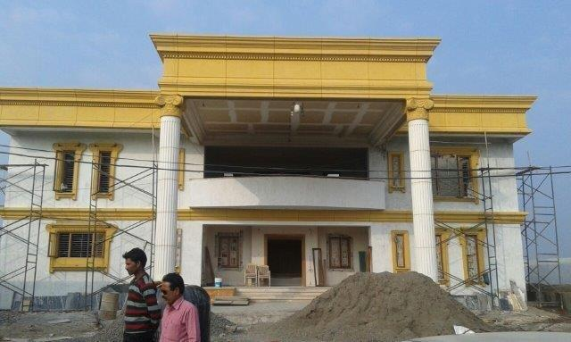
GRC IS MOST SUITABLE FOR RENNOVATION
VILLA AT BELGIUM RENNOVATED WITH GRC ELEMENTS – TURNING DREAMS INTO REALITY

Slide 28
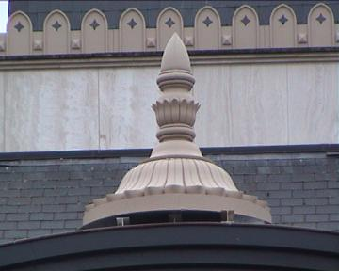
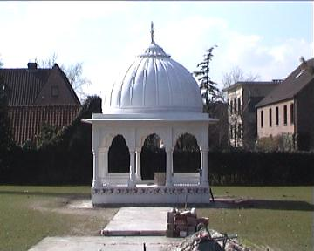
GRC IS MOST SUITABLE FOR RENNOVATION
VILLA AT BELGIUM RENNOVATED WITH GRC ELEMENTS – TURNING DREAMS INTO REALITY

Slide 29
USES OF GRC - FEATURES & MOULDINGS
GRC products are formed by a variety of manufacturing techniques. One of the most versatile is to cast the composite in moulds manufactured from rubber, timber or Glassfibre Reinforced Plastic (GRP/FRP). This is known as Premix GRC. As the high-performance alkali resistant glass fibres are evenly distributed in the mix, the material is reinforced throughout, enabling products with the finest of details to be created.
GRC can be cast into fine details
GRC offers designers unrivalled flexibility
GRC mouldings and features are easy to handle and erect
GRC does not suffer from corrosion
GRC is used to produce beautiful architectural mouldings and features. Whilst often cast with thicknesses in excess of 25 mm these products remain easy to handle and erect, and permit the architect or engineer an unrivalled freedom for creative design. GRC does not suffer from corrosion of the reinforcement. Unlike traditional concrete, GRC does not require a minimum of concrete cover to the reinforcement.

Slide 30
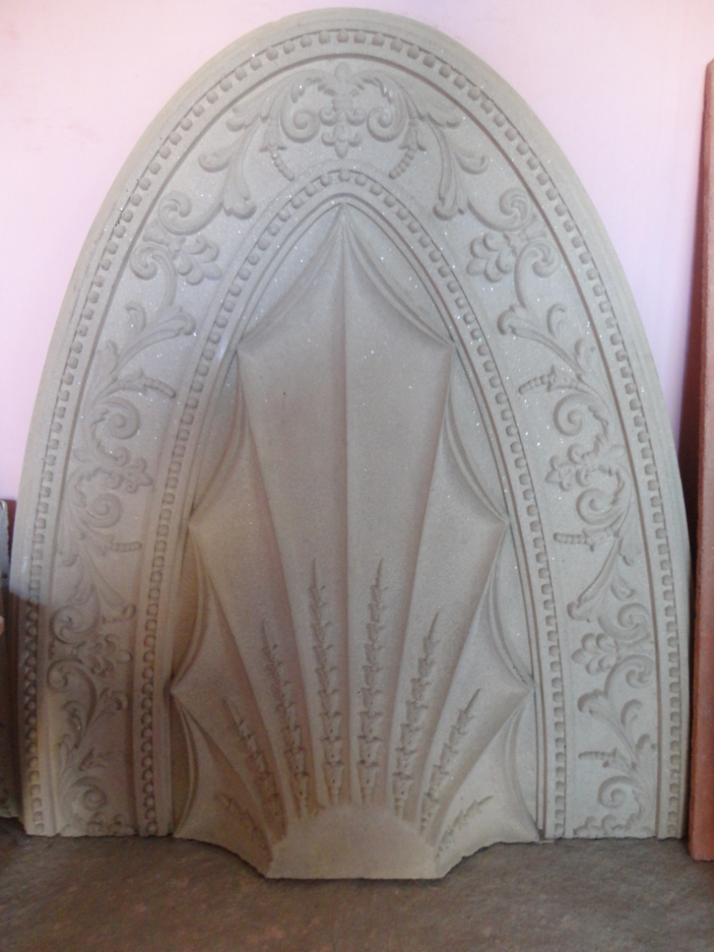
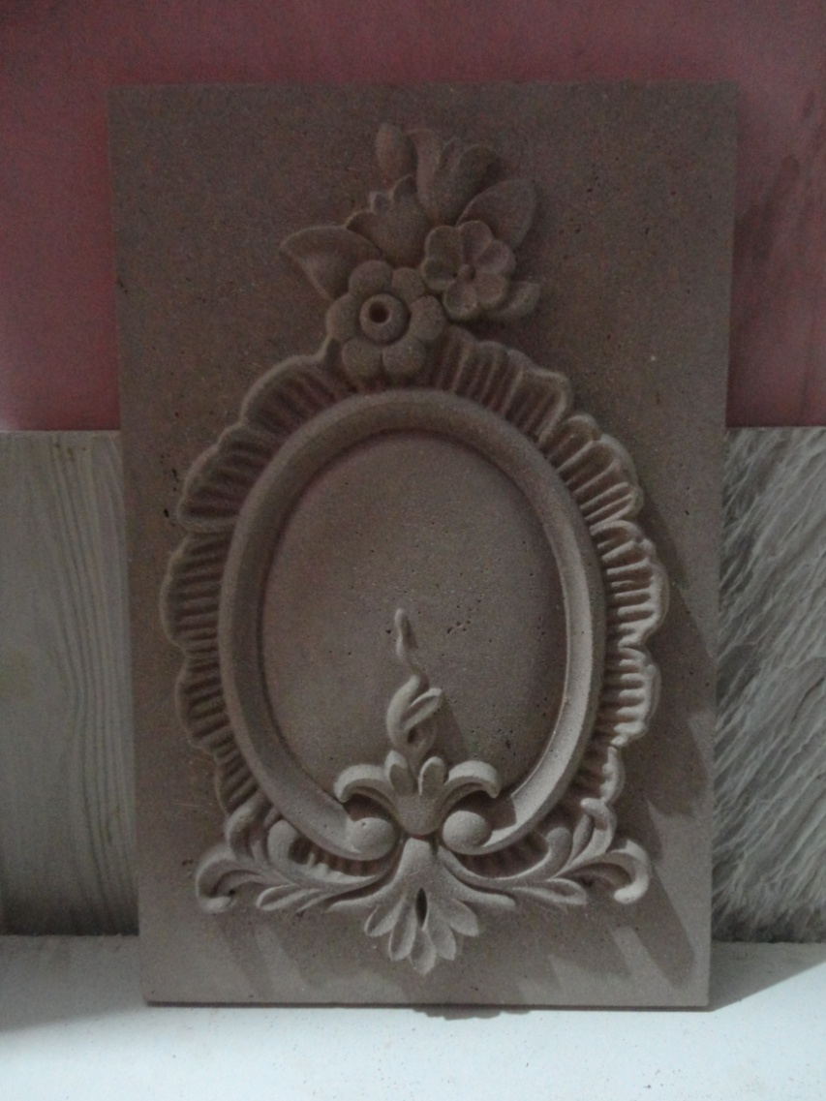
WE BRING LIFE TO ARCHITUCTURAL DESIGNS
INTRECATE DESIGINS IS POSSIBLE IN GRC WITH MOLDS CREATED IN RUBBER.

Slide 31
USES OF GRC - LANDSCAPING
In building projects, leisure facilities, urban renewals and municipal schemes ever-increasing attention is being focused on the built environment. GRC is playing a major role.
GRC is environmentally friendly
GRC is durable against extreme weather conditions
GRC products are lightweight and easy to handle
GRC offers a wide variety of shapes and surface finishes
Seating, planters, receptacles, kiosks, bollards, signs, statues and fountains, to name but a few, all benefit from being made in GRC with its ability to tailor shape, form and surface finish and to be aesthetically compatible with the chosen environment.
GRC also provides theme park and zoological architects with a medium through which they can turn dreams into reality. Many of the world’s largest theme parks and zoos use
GRC to create rockscapes, replica buildings, simulated environments for animals, and much more.

Slide 32
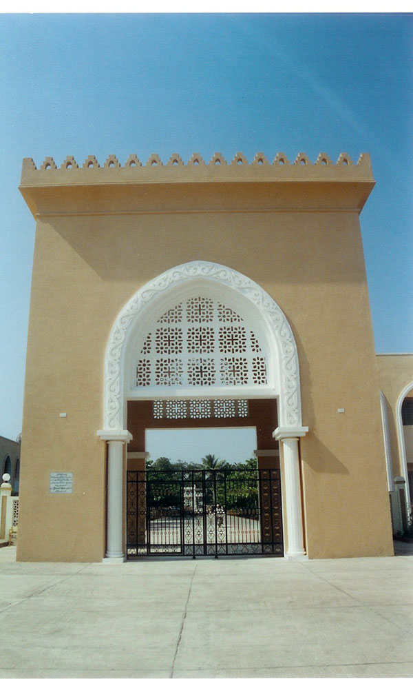
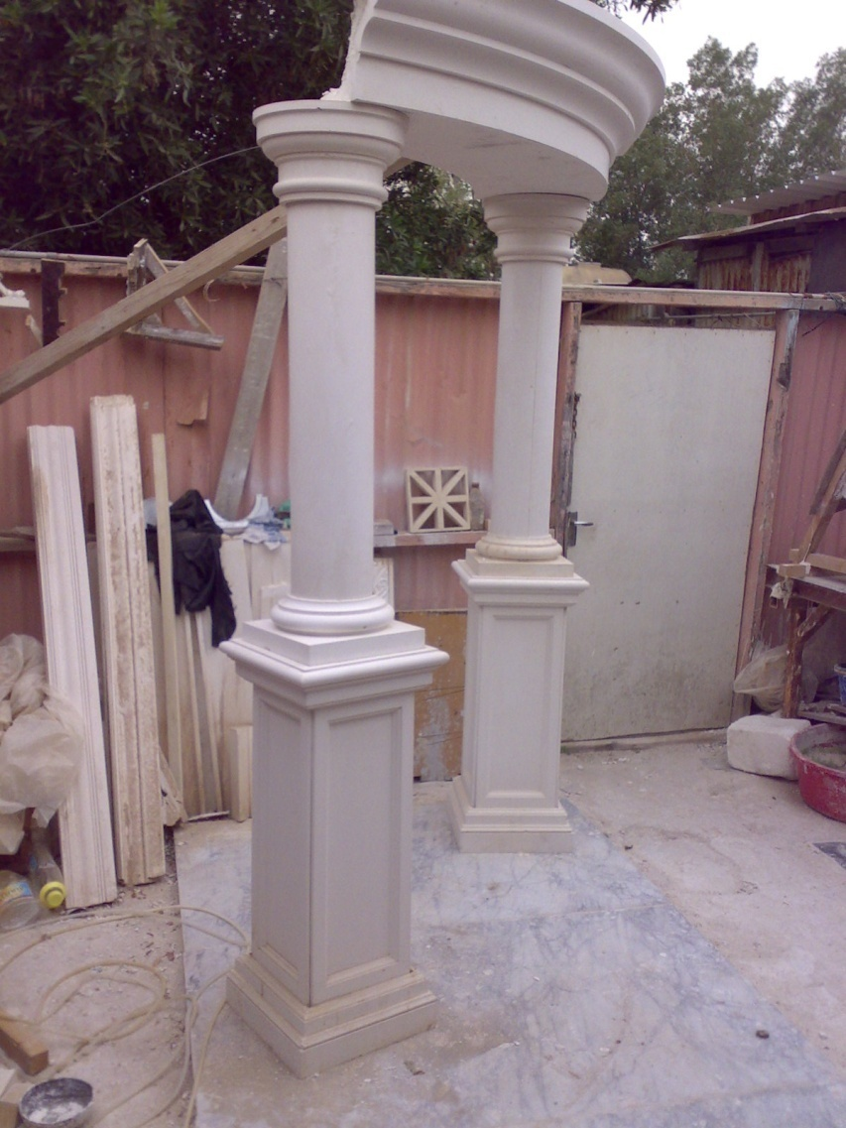
WE BRING LIFE TO ARCHITUCTURAL DESIGNS
INTRECATE DESIGINS IS POSSIBLE IN GRC WITH MOLDS CREATED IN RUBBER.

Slide 33
typical properties of grc ………
property |  | hand / machine spray | vibration cast
glassfibre
weight % |  | 5
bending
ultimate strength (MOR) | MPa | 20-30 | 10-14
elastic limit (LOR) | MPa | 7-11 | 5-8
shear
interlaminar strength | MPa | 3-5 | NA
in-planar strength | MPa | 8-11 | 4-7
compressive strength | MPa | 50-80 | 40-60
impact strength | Kj/m2 | 10-25 | 10-15
elastic modulus | GPa | 10-20 | 10-10
strain to failure | % | 0.6-1.2 | 0.1-0.2
dry denstity | t/m3 | 1.9-2.1 | 1.8-2.0

Slide 34
Contact details
GFRC FACADES.
GFRC / GRC, GRG CEILINGS & PANELS, FRP WORKS, HIGH END DECORATIVE & ARCHITECTURAL WORKS & ACOUSTIC SOLUTIONS WITH EXPERTISE IN HOME THEATRES
SRIHARI NILKAR
MUMBAI
Mobile: 9867569395
nilkarsrihari@gmail.com

